Slide 1
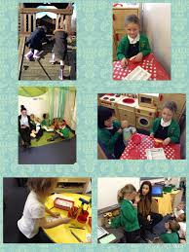
Reading & Phonics at Davyhulme Primary School

Slide 2
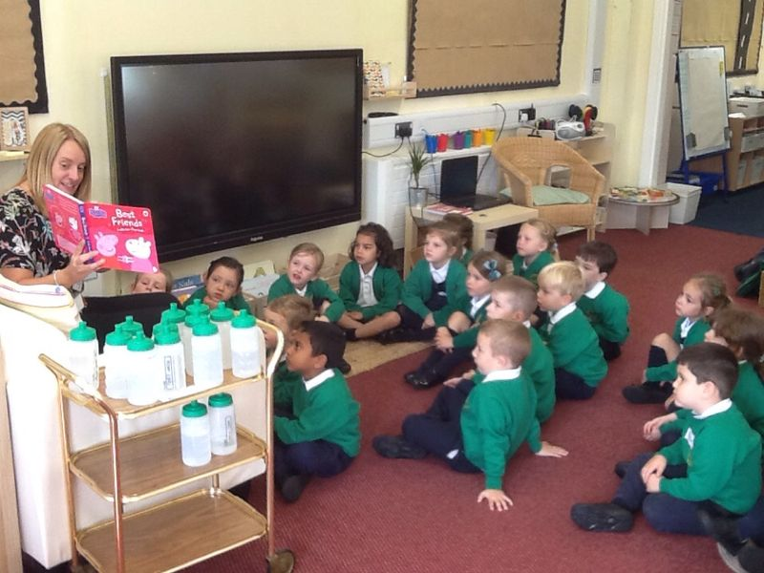
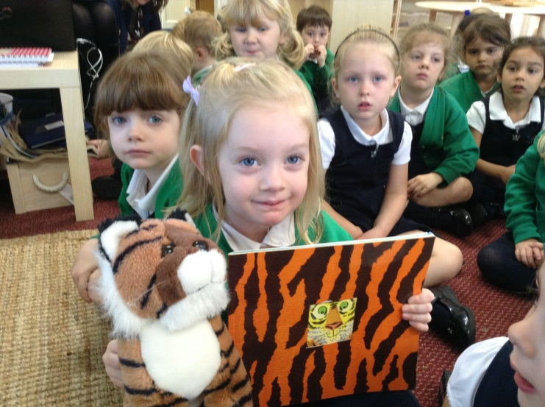
Agenda
How do children learn to read?
How do we help children at school?
How can you help at home?
Any questions?

Slide 3
How do children learn to read? What are phonics?

Slide 4
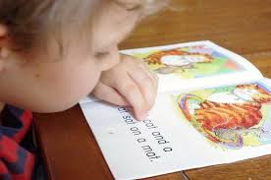
Learning to read is probably the most important thing your son or daughter will do in Reception (well, maybe equal with having fun!) but it won’t all happen in class: parents need to help at home too.
The way reading is taught has changed over the years, The current favoured method in British primary schools is through phonics. The Government has backed this approach and it’s definitely here to stay for the foreseeable future.

Slide 5
How do children learn to read?
As they listen to favourite stories and retell them on their own,
As they name letters of the alphabet & play with sounds
As they see environmental print/signs- logo on a sign for a favourite restaurant (McDonalds)
Watch adults read and copy/gain an interest in reading
As their language skills grow, young children tell and retell stories,
They identify printed words such as their names,
They write their names on paintings and creations, and incorporate writing in their make-believe play.
After listening to a story, they talk about the people, feelings, places, things, and events in the book and compare them to their own experiences.

Slide 6
How do children learn to read?
The emerging pre-reader (typically between 6 months to 6 years old);
The novice reader (typically between 6 to 7 years old);
The decoding reader (typically between 7 - 9 years old);
The fluent, comprehending reader (typically between 9 - 15 years old); and
The expert reader (typically from 16 years and older).

Slide 7
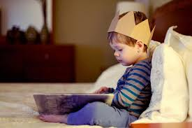
Research has shown that phonemic awareness is the best predictor of early reading skills. Phonemes, (the smallest units of sounds), form syllables, and words are made up of syllables. Children who understand that spoken language is made up of discrete sounds – phonemes and syllables – find it easier to learn to read.
Many children develop phonemic awareness naturally over time. Simple activities such as frequent reading of familiar and favourite stories, poems and rhymes can help children develop phonemic awareness. Other children may need to take part in activities designed to build this basic skill.

Slide 8
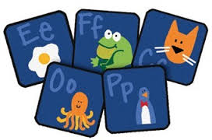
Phonics is all about using …
skills for reading and spelling
knowledge of the alphabet
+
Learning phonics will help your child to become a good reader and writer.

Slide 9
Phonics vocabulary
Phoneme (sound)
Grapheme (a letter or letters that make a sound)
Blending (putting sounds together to a make word)
Segmenting (breaking word into sounds)
Digraph (2 letter sounds /oo/ /ch/)
Trigraph (3 letter sounds /igh/air)
CVC (consonant, vowel, consonant)
Sound button (press 1 button for each sound)
High Frequency Words (most frequently written words)
Tricky Words (words which cannot be sounded out – only learnt)

Slide 10
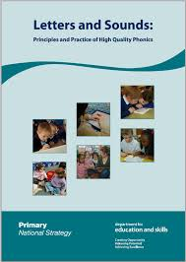
How do we help children at school?
Every child in Reception and KS1 learns
daily phonics at their own level
Every day the children have 20 minute sessions of phonics teaching
Lessons encompass a range of games, songs and rhymes
We use the ‘Letters and Sounds’ planning document to support the teaching of phonics.
There are 6 phonics phases which the children work through at their own pace. Phases 1-4 are taught in Reception.

Slide 11
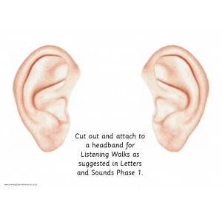
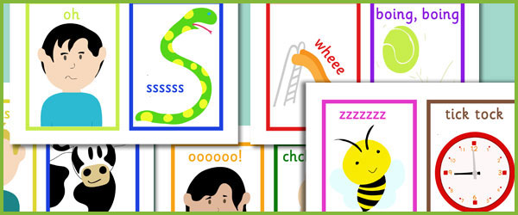
Phase 1: (Nursery & Reception) Getting ready for phonics
1. Tuning into sounds
2. Listening and remembering sounds
3. Talking about sounds
Music and movement
Rhythm and rhyme
Sound effects
Speaking and listening skills

Slide 12
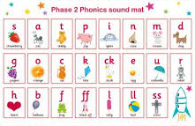
Phase 2: (Reception) Learning phonemes to read and write simple words
Children will learn their first 19 phonemes:
Set 1: s a t p
Set 2: i n m d
Set 3: g o c k
Set 4: ck (as in duck) e u r
Set 5: h b l f ff (as in puff) ll (as in hill) ss (as in hiss)
They will use these phonemes to read and spell simple “consonant-vowel-consonant” (CVC) words:
sat, tap, dig, duck, rug, puff, hill, hiss
All these words contain 3 phonemes (sounds)

Slide 13
Phase 3: (Reception)
Learning the long vowel phonemes
Children will enter phase 3 once they know the first 19 phonemes and can blend and segment to read and spell CVC words.
They will learn another 26 phonemes:
j, v, w, x, y, z, zz, qu
ch, sh, th, ng, ai, ee, igh, oa, oo, ar, or, ur, ow, oi, ear, air, ure, er
They will use these phonemes (and the ones from Phase 2) to read and spell words:
chip, shop, thin, ring, pain, feet, night,
boat, boot, look, farm, fork, burn,
town, coin, dear, fair, sure

Slide 14
Saying the sounds
Sounds should be articulated clearly and precisely.
www.youtube.com/watch?v=IwJx1NSineE

Slide 15
Phonics Words
Your children will learn to use the term:
sound (phoneme)
sounds that can be heard in words e.g. c-a-t

Slide 16
Phonics Words
Your children will learn to use the term:
Blending
Children need to be able to hear the separate sounds in a word and then blend them together to say the whole word .

Slide 17
Blending
/b/ /e/ /d/ = bed
/t/ /i/ /n/ = tin
/m/ /u/ /g/ = mug

Slide 18
Phonics Words
Your children will learn to use the term:
Segmenting
Children need to be able to hear a whole word and say every sound that they hear .

Slide 19
Segmenting
bed = /b/ /e/ /d/
tin= /t/ /i/ /n/
mug= /m/ /u/ /g/

Slide 20
Phonics Words
Your children will learn to use the term:
Grapheme (letter name)
This is how a sound is written down

Slide 21
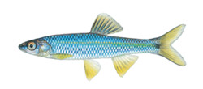
Phonic Words
Phoneme frame and sound buttons
c | a | t
. . .
f | i | sh
. . _

Slide 22
Phonic Words
How to play phoneme frames:
Say it, robot sounds (segment) and say the word (blend)
Now can you write the sounds you hear in the phoneme frame?

Slide 23
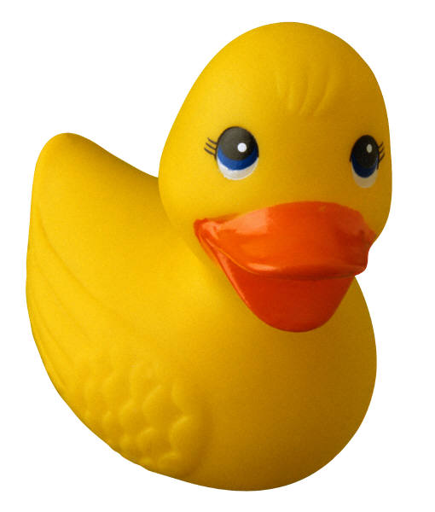
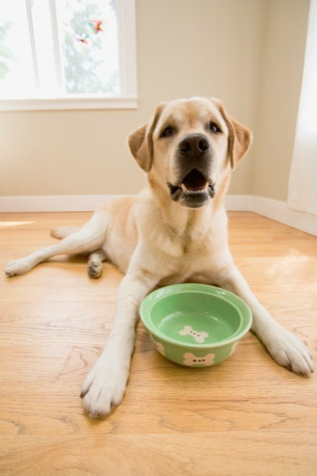
Phoneme frames activity
d e u g o n
t ck

Slide 24
Phonics words – Tricky Words
There are many words that cannot be blended or segmented because they are irregular.
the was said you some
These words need to be learnt by looking at them and recognising them

Slide 25
Reading opportunities in School
Book of the week
RED TED – (Read Every Day, Talk Every Day)
Story time (x2 a day)
Book areas/nooks in & outside
Shared reading (whole class)
Guided Reading (taught small groups)
Individual Reading (Home reading books)
Daily Phonics lesson
Audio Stories/Stories on screen
School Library sessions/visits

Slide 26
School Reading Schemes
Reading Planet Bug Club Rigby

Slide 27
How can I help at home?
Talk with your child about what they have read at school
Read the Reading book everyday with your child and write how they did in the planner
Phonics Packs for every child in Reception
Practise the phonemes together – robot talk, I-spy games using sounds (something that begins with ……. ends with ……… middle sound is…………)
Use sound cards to make words and change one at the time to make different words at home and play phonics games
Learn the tricky words
Visit some of the suggested reading websites together
Bedtime story – reading for pleasure

Slide 28
Don’t forget…
Learning to read should be fun for both children and parents.

